Slide 1

Division of Research Innovation and Ventures
Sandeep Patel, PhD
DRIVe Director

Slide 2
Investing in the Future of Health Security

Slide 3




BARDA Program Divisions
Medical Countermeasures (MCM) Program
Influenza & Emerging Infectious Diseases
Chemical, biological, radiological and nuclear (CBRN) Program
Detection, Diagnostics, & Device Infrastructure
Pharmaceutical Countermeasure Infrastructure
Division of Research, Innovation, and Ventures (DRIVe)

Slide 4

DRIVe’s Approach to Innovation
We change how government approaches big health security challenges and threats
We tackle health security threats by seeking breakthrough devices and technologies
We model our work on the best practices of the entrepreneurial world
We use tools and authorities to support new technologies, streamline contracting processes, and launch a network of accelerators
The team is comprised of scientists and venture entrepreneurs dedicated to identifying threats to health security

Slide 5
DRIVe Program Areas
ENACT
SEPSIS
DRIVe
CATALYST OFFICE
Supporting pathogen-agnostic technologies that enable earlier infection diagnoses
Reducing the incidence, morbidity, mortality, and cost of sepsis
Bridging the intersection between the science and the business world

Slide 6
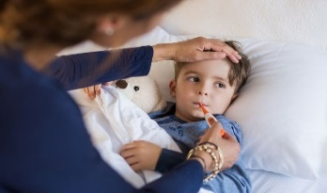
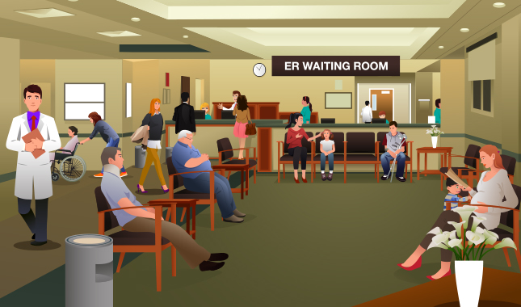
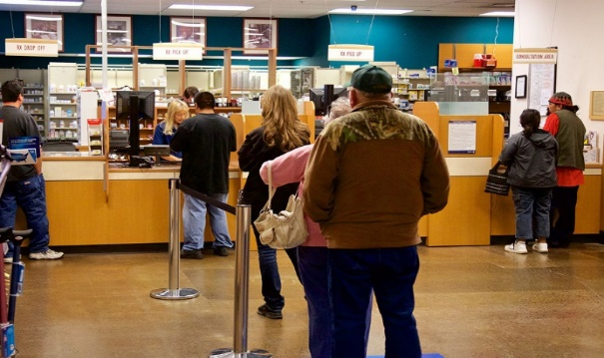
Traditional healthcare paradigm
Cost to the individual
Long wait times
Prolonged illness
Risk of disease progression
SYMPTOMS
DIAGNOSIS
TREATMENT
Costs to the community
Delays cause burden to healthcare system
Loss of productivity
For infectious disease: risk of transmission and spread in the community; lack of resources
Difficult to differentiate illness
Patient can be a transmission vector before noticeable symptoms
Appointment with healthcare provider
Wait at clinic or emergency room
Filling prescriptions
Many treatments work best when given early
Notes:
Many diseases share similar symptomatology
Prodromal period is one of the four major stages of a disease. The first stage is referred to as the incubation period followed by a prodromal period. At prodromal period, the symptoms may not be very specific or severe. The affected person can still perform usual functions although distress or discomfort may be felt.

Slide 7


Supporting pathogen-agnostic technologies that enable earlier infection diagnoses
Empowering individuals to take early action on their health
Providing early actionable information to medical care providers; patient triage
Following the spread of an epidemic in near real-time
Act
Pre-symptomatic information: Empowering patients
Treat
Early diagnostics for medical care providers
Control
Actionable information for public health organizations
Notes:
“Enable triggers for home testing that is being supported by diagnostics division”
“Enhance the efficacy of clinical trials by enabling passive monitoring of health status of participants”

Slide 8








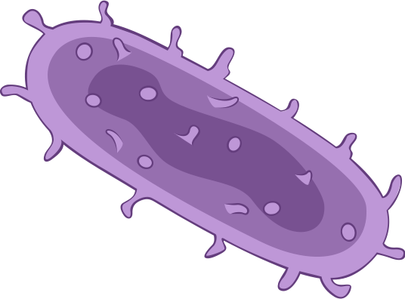

Hemorrhagic fevers
Emerging Unknown Threat
Anthrax
All Roads Can Lead to Sepsis
Influenza
Sepsis is a secondary confounder that arises from primary infection or secondary infection from a primary insult (burn, etc) and threatens our ability to protect our Nation
Plague

Slide 9






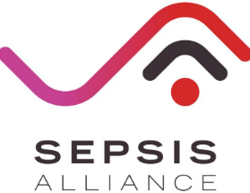



















DRIVe Portfolio
25
Funded companies
$30.7
Million funded
$20.7
Million cost share

Slide 10





























DRIVe COVID-19 Portfolio
33
Funded companies
$19.5
Million funded
$15.3
Million cost share
Notes:
Total funding does not include the $7.3M awarded to Cytovale, Beckman Coulter, Sonica, and Sepsis Alliance that have partial COVID-19 Scope in the contract but exact dollar amount is hard to state

Slide 11

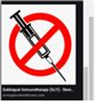

Emerging Program Areas
DRIVe has also created a new process called DRIVe Start to rapidly seed new program areas
COVID-19 Rapidly Deployable Capabilities
Vaccine Delivery
Triaging severely-ill and empowering patient self-monitoring
Developing alternatives to traditional needle/syringes to enable broader access

Slide 12
COVID-19 Rapidly Deployable Capabilities
Empower the Patient
Empower the Health Care Provider
Allocate Hospital Resources
Self-monitor for infection
Early detection of health deterioration → early testing, intervention, isolation (reduce spread)
Monitor mild/moderate illness during self-quarantine to determine when need hospital care
Remote monitoring of patients and determine need for escalated care; prognosticate outcomes
Triage severely ill to determine need for Hospital care (~20%) /ICU (~5%) care
Identify health deterioration or decompensation in patients that need care to allocate/shift resources (personnel, equipment, etc.)
Multi-partner collaboration collating wearable & testing data to assess high-risk individuals (HCPs) and stratify risk
Vital Solution wearable (FDA cleared) to monitor nursing home patients (VA) and COVID-19 patients for health deterioration
Rapid sepsis diagnostic COVID-19 Pilot study: ED, respiratory illness PUI to triage for viral sepsis
Aura, an early warning platform for COVID-19 infection to facilitate early intervention
COVID-19 webinars for Healthcare professionals
Machine learning algorithm based on vital sign (EHR) and clinical data (MDW, FDA cleared) to detect viral sepsis
Expanding on existing partnership to include early identification of COVID-19 via wearable sensors​
Blood based host biomarker in vitro diagnostic to inform on sepsis (ICU and ED)

Slide 13
DRIVe R&D Funding Vehicle
Easy Broad Agency Announcement (EZ-BAA) is designed to be fast, easy-to-use, and flexible
Inspired by DARPA
$749,999 max & 30-50% cost share requirement
Can go from posting solicitation to award within 30 days
BARDA DRIVe Abstract Review Process Flow Chart
Market Research Call with DRIVe AOI PM
Abstract to Award = 30 to 120 Days
Abstract Submission
Award
Successful Negotiation
Acceptable
Initial Abstract Review
Proposal Evaluation
Interested
Submission of SOW
Cost & Technical Information
Not Interested
Not Accepted
Respondent Notified
Respondent Notified

Slide 14
BARDA DRIVe’s Catalyst Office
Justin Yang
Director

Slide 15


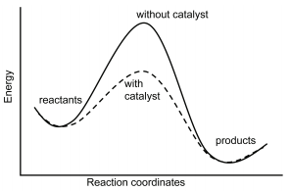
INTRODUCING…THE CATALYST OFFICE
Serving to bridge the intersection between the science world and business world
Three cornerstone programs within Catalyst:
Accelerator Network
BARDA Ventures
DRIVe Start
CATALYST: a substance that increases the rate of a chemical reaction without itself undergoing any permanent chemical change.

Slide 16
Bridging the Valley of Death
Post-
Market
Where can we catalyze to bridge the valley of death?
Project Bioshield/
SNS/DPA/DFC
CMS/Payer
As we move to the next stage:
Number of candidates decrease
Funding required increases
Level of funding decreases
Advanced Development & Clinical Trials
BARDA Ventures/
BARDA BAA
DTRA/JPEO
Basic/Translational
Research
BARDA Ventures/
BARDA EZ-BAA/
DRIVe Start
NIH/DARPA

Slide 17
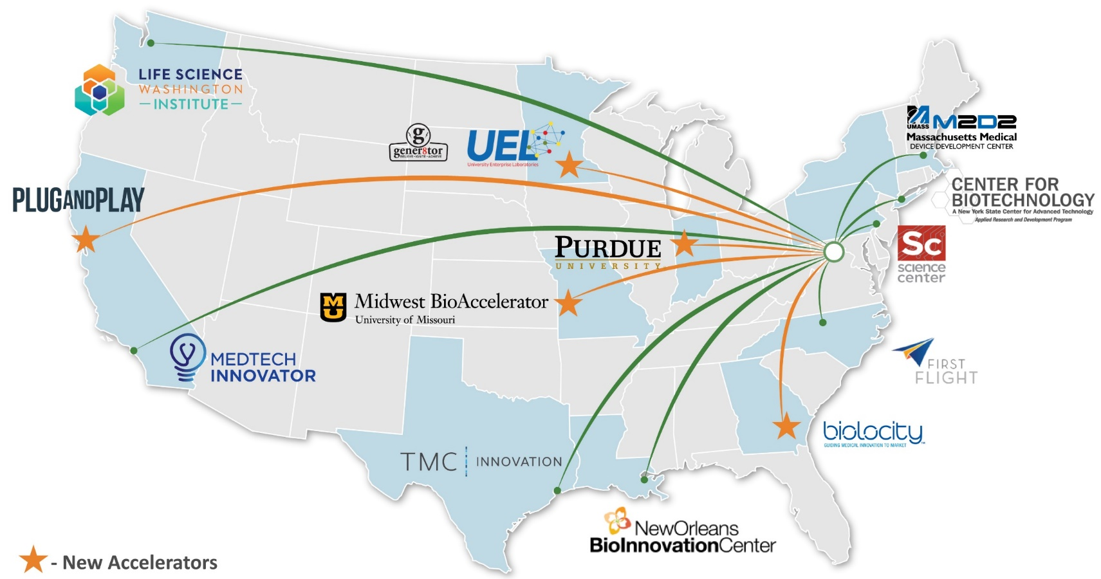
What have we been up to this past year?
DRIVe added five new accelerators:
Plug and Play (CA)
University Enterprise Labs / Genera8tor (MN)
Uni. Of Missouri (MO)
Biolocity (GA)
Purdue (IL)

Slide 18
What have we been up to this past year? (Cont.)
1
2
3
4
5
6
Leveraged accelerators’ insight to surface market innovation trends
BARDA Reverse pitch series at monthly Accelerator All Hands
COVID-19 specific webinars – held by all 13 accelerators
Deal flows, programs and startup 1x1’s specific to DRIVe and/or COVID-19
Accessed untapped applicant pools for BARDA solicitations (BARDA, DRIVe, COVID-19 IMT)
Added strategic partners
Notes:
Leveraged accelerators’ insight to surface market innovation trends:
Landscape reviews to assist market research, in support of BARDA MCM divisions
Ventures market survey responses
BARDA Reverse pitch series at monthly Accelerator All Hands
COVID-19 specific webinars – held by all 13 accelerators
Deal flows, programs and startup 1x1’s specific to DRIVe and/or COVID-19
Accessed untapped applicant pools for BARDA solicitations (BARDA, DRIVe, COVID-19 IMT)
Added strategic partners:
Industry: accelerators/incubators outside our formal network now working with DRIVe
DREAMIT Ventures, MATTER, MassBio, MassChallenge, BioHealth Innovation, Capital Factory, Y-Combinator, Brigham and Womens iHUB, Stanford Innovation Lab, Mayo Clinic Ventures
Government: EDA, VHA and SBA innovations groups

Slide 19
What are we planning to do this year?
1
2
3
4
Accelerate DRIVe-funded companies:
Address company hurdles (product or business)
Connect to potential investors and/or strategic partners
Participate in accelerator programs or bootcamps
Work with DRIVe Start on BARDA challenges executed by accelerators, for example, M2D2 Barracuda Bowl
Deepen interagency collaborations (i.e. VHA, SBA, EDA)
Increase efforts to quantify accelerator network impact
CRM for company referrals
Website redesign and measure traffic
Notes:
E.g. Connect to potential investors and/or strategic partners (i.e. health systems for pilots, industry for strategic partnerships, clinical community for product/UX feedback)

Slide 20
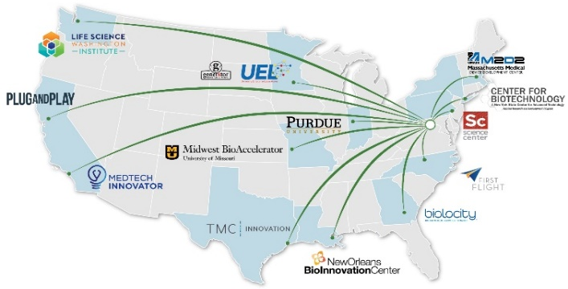
The DRIVe Accelerator Network
Tech Scouting, Wrap-around Support, Programs & Events, Networking
Identifying and connecting our early-stage R&D partners with regional accelerators to speed innovations in health security

Slide 21

BARDA Ventures
Initiative to redefine how USG partners with private sector to advance health security
21st Century Cures Act directed BARDA to enter into this partnership
Seeking to partner with an existing non-profit entity (Managing Entity) that will utilize “venture capital practices and methods to address urgent health security needs” through equity investing
Investing, developing, and harnessing technologies to improve preparedness posture against known and unknown threats

Slide 22

DRIVe Start Overview
Program Innovation & Alliance Team
Kerrie DeMarco, Ph.D.
Kumiko Lippold, Ph.D., MPH

Slide 23
DRIVe Start – Program Innovation & Alliance Activities
Explore New Opportunities
Engage the Community
Develop & Foster
Collaboration
Identify and explore new exciting areas for innovation:
Tuesday Talk Series
DRIVe Challenge events
Accelerator Network Events
DRIVe Start Incubators
Engage internal & external partners through:
Meet & Greet Events
Demo & Pitch Days
BARDA Industry Day
Social Media Outreach
Conferences & Discussion Panels
USG Interagency Partnership Panels
Increase BARDA division collaborations for tech transfer
Expand partnerships with ↑ MOU/MOA/IA
Notes:
Building relationshps
Community Engagement
+ third category

Slide 24



DRIVe Start Program Innovation Activities PROGRAM BACKGROUND
A program designed to find new ideas and support their development through:
Tuesday Talk Series
Prize Competitions
DRIVe Start Incubator*
DRIVe Start Talk Series
DRIVe Start Prize Challenges
DRIVe Start
Incubator
* Internal USG only

Slide 25
DRIVe Start Talks WEEKLY TUESDAY TALK SERIES
Designed to facilitate an open and collaborative culture among the DRIVe team and encourage the presentation and development of new ideas, capabilities, and approaches to health security issues.
Who Can Present?
What topics can Talks cover?
How do I submit a Talk proposal?
Anyone with a great idea, including those internal and external to USG
Ideas relevant to BARDA’s mission spaces and priorities are preferable, but presentations can cover a wide range of ideas with approval
Follow the instructions in the DRIVe Start wiki for guidance on submitting a topic or speaker of interest

Slide 26
DRIVe Start PRIZE CHALLENGES
The DRIVe team is exploring novel ways to partner with industry and address some of the most challenging health security issues!
We are exploring ways to utilize BARDA DRIVe’s ability to spur innovation with:
Prize Challenge Competitions
Grand Challenges
Hack-a-thons
Be on the look-out for BARDA DRIVe Challenge announcements coming soon!

Slide 27
How can you work with us?
Share your science and ideas
DRIVe Start Tuesday Talks are not opportunities for product pitches, but are opportunities to share information about exciting new research. We want to hear about novel ideas that push the boundaries of what is possible
Reach out to us
We want to learn more about you and your organization’s capabilities. If we know what you offer, we can find new opportunities for partnership

Slide 28
How the Catalyst Office will Help…
Equity investments pre/post EZ-BAA through BARDA Ventures
Incubate and launch new programs through DRIVe Start
The DRIVe Catalyst Office will close the gap between business and science
Bring both industry partners and government partners to the table
Constantly challenge the status quo
Amplify and catalyze investments through the Accelerator Network
Develop market intelligence reports and landscapes
Lead efforts in scaling, transition, and advancement for all of DRIVe

Slide 29
BARDA DRIVe’s ENACT Program
Šeila Selimović, PhD
Director, ENACT Program

Slide 30

Can infectious disease be detected inside the body prior to the onset of noticeable symptoms – using minimally invasive techniques?
Does a “health” signature exist – for an individual or across population groups?
If so, is the signature similar across any given population group (by age, biological sex, ethnicity, health status, behavior status (e.g. activity level; smoking etc.)?
Does a concrete “illness” signature exist for an individual or across population groups?
Does the signature depend on the type of infection?
What is the time period between onset of the “illness” signature and obvious symptoms?
Act
Pre-symptomatic information: Empowering patients
Notes:
Question: Can we predict onset of infectious disease pre-symptomatically using minimally invasive methods?
Do “Health/Illness” signatures amenable to minimally invasive techniques exist?
What is the predictive value of any signature that may be identified?
Does it work across age/sex/other demographics?
Does it provide signals hours or days prior to symptom onset?

Slide 31
How can early infection information be useful to health care organizations: pharmacies, hospitals, health departments?
Can wearable sensors and telehealth solutions provide now-casting of infectious disease incidence?
Can these technologies distinguish between infections caused by different pathogens?
Control
Next hot spot? Can hospitals allocate their resources?
Notes:
Question: Can we predict onset of infectious disease pre-symptomatically using minimally invasive methods?
Do “Health/Illness” signatures amenable to minimally invasive techniques exist?
What is the predictive value of any signature that may be identified?
Does it work across age/sex/other demographics?
Does it provide signals hours or days prior to symptom onset?

Slide 32
Can infectious disease be detected / determined based on the host response and through on-demand tests?
Do viral and bacterial infections provide different physiological and biomarker signatures?
Can actionable infection information be provided early to the medical care provider?
Treat
Early diagnostics for medical care providers
Notes:
Question: Can we predict onset of infectious disease pre-symptomatically using minimally invasive methods?
Do “Health/Illness” signatures amenable to minimally invasive techniques exist?
What is the predictive value of any signature that may be identified?
Does it work across age/sex/other demographics?
Does it provide signals hours or days prior to symptom onset?

Slide 33




ENACT Investment Areas - Vision
Act
Pre-symptomatic information: Empowering patients
Treat
Early diagnostics for medical care providers
MICRONEEDLE
LAB-ON-A-DUST
Control
Actionable information for health care organizations
Notes:
Technologies:
1.) Non-invasive health monitoring: smart devices (Spire washable tag, Biobeat watch, Empatica wristband)
2.) Non-invasive health monitoring: Smart app (Evidation)
3.) On-body continuous monitoring devices (Sonica sticker, EnLiSense band, Stanford Medicine microneedle patch, UC San Diego wearable focused ultrasound system
4.) In-home monitoring (Sound Life Sciences)
5.) Telehealth (98point6)
6.) Point-of-care / on-demand analysis (Rizlab Health cytotracker, Stanford Medicine Lab-on-a-Dust, GE Healthcare ultrasound detector)

Slide 34
ENACT Portfolio: Sensing Mechanisms
(Percentages are rounded)

Slide 35
ENACT Portfolio: Biophysical Markers

Slide 36
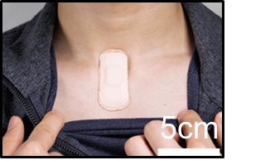
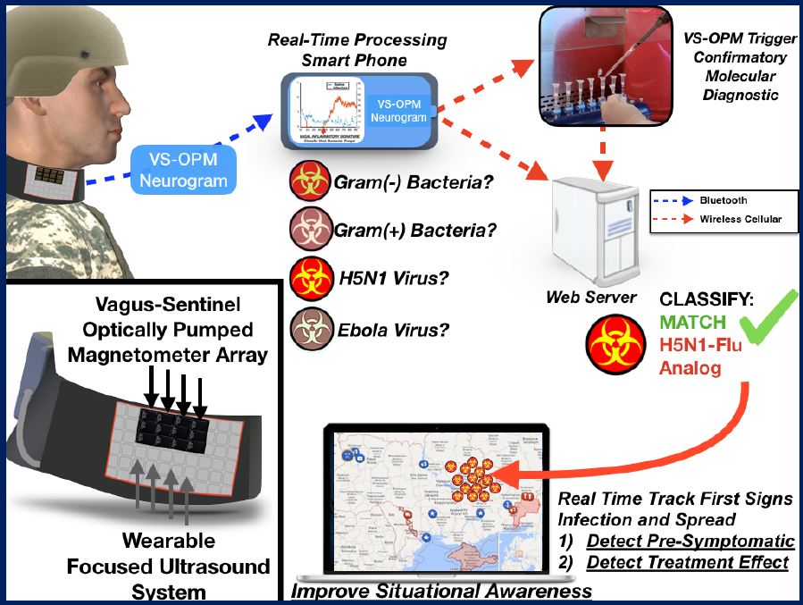

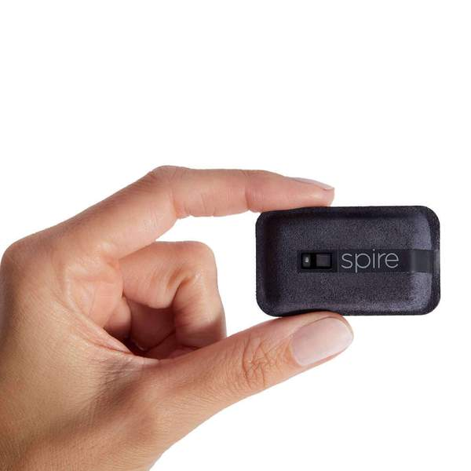

Biophysical Continuous Monitoring Devices
wearable focused ultrasound system
Acousto-mechanic sensing
Assesses cardio-pulmonary health
Vital sign monitoring
Respiration rate tracking equivalent to medical grade monitoring
Heart rate and heart rate variability
Sleep / sleep quality
Activity
Stress
Vagus nerve firing indicates immune system status
Bacterial vs viral infections
Detects pre-symptomatic infection
Detects treatment effect
Real-time tracking
Notes:
I would differentiate Slide 9 (Purely Biophysical continuous monitoring) from Slide 11 (Bio chemical continuous monitoring) and group Sonica and UCSD with Spire, BioBeat and Empatica
Sonica: Advanced, acoustomechanic (ADAM) system provides comprehensive assessment of cardiopulmonary health employing low power, in-sensor analytics & cloud integration.
ADAM’s full suite of digital biomarkers:
1) Predict for impending respiratory infection
2) Warn of continued infectiousness
3) Identify treatment non-responders
4) First responders can apply patch for continuous vital sign monitoring
UC San Diego: Low-profile wearable device that can be worn on demand
Measuring changes in vagus nerve firing indicates immune system status and activation
Device is envisioned to detect pre-symptomatic infections anywhere in the body
Allow individuals to monitor themselves for signs of impending disease
Allow clinicians to monitor patients after discharge for infection
Enhance capabilities of first responders to monitor patients in transit
Ge: StimResponse: Novel Ultrasound Immune Response Profiling Tool for Pre- symptomatic Pathogen Exposure Detection
Concept: Non-invasive ultrasound test will detect pre-symptomatic exposure to pathogens via development of stress model involving biomarker signatures and stimulation inputs.
No biological sample required.
Ultrasound to different body locations drives different immune cell response profiles
Expanding use of technology from therapeutic (DARPA) to diagnostic (BARDA)
Biomarkers measured before and after ultrasound on subjects exposed to LPS, flu and pneumonia (multiple time points; non-exposed control subjects)
Stanford (middle):
Microneedle patch coupling electrodes to structure-switching aptamers.
Continuously monitors CRP, Glucose, IP10, TRAIL in the interstitial fluid
Can monitor multiple biomarkers once every 5 min. for up to 2 weeks
Enables pre-symptomatic monitoring and drug dose management in clinical trials or patient treatment/Emergency responders

Slide 37
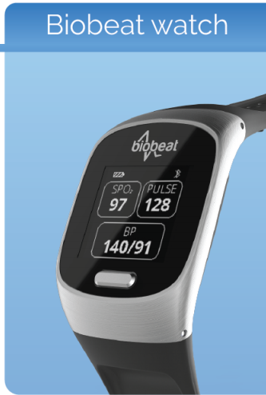
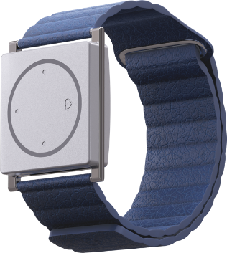


Biophysical Continuous Monitoring Devices
FDA cleared for:
Blood pressure
Pulse rate
Blood oxygenation
21 other parameters
Electrodermal Activity (EDA) measurement of nervous system response
FDA cleared for seizure prediction
Is EDA a surrogate for immune activation?
Sleep, movement

Slide 38

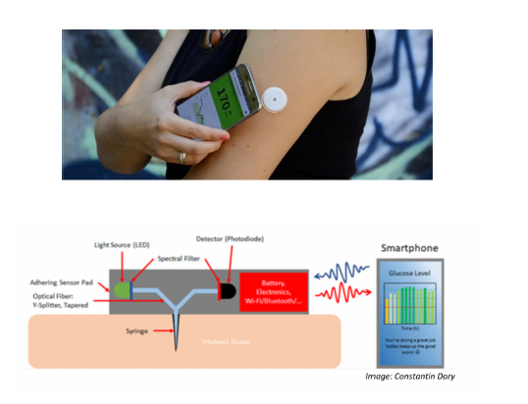
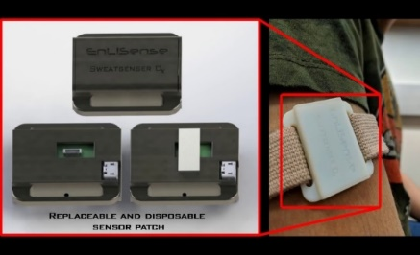
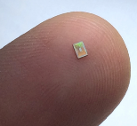

Biochemical Continuous Monitoring Devices
Interrogates eccrine sweat - measured every minute for up to 72 hours
IL6, IL8, IL10, TNFa, TRAIL, IP10
Microneedle patch
Glucose, IP10, TRAIL
Monitors multiple biomarkers every 5 min for 2 weeks
Pre-symptomatic monitoring / drug dose management
Notes:
Track individual health signatures from wellness to illness through non-invasive health monitoring
Partnering with DARPA on clinical studies during Flu season collecting health signature data coupled to pathogen identification and biomarker discovery to identify signs of impending disease

Slide 39

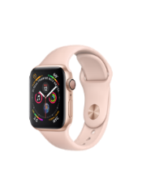
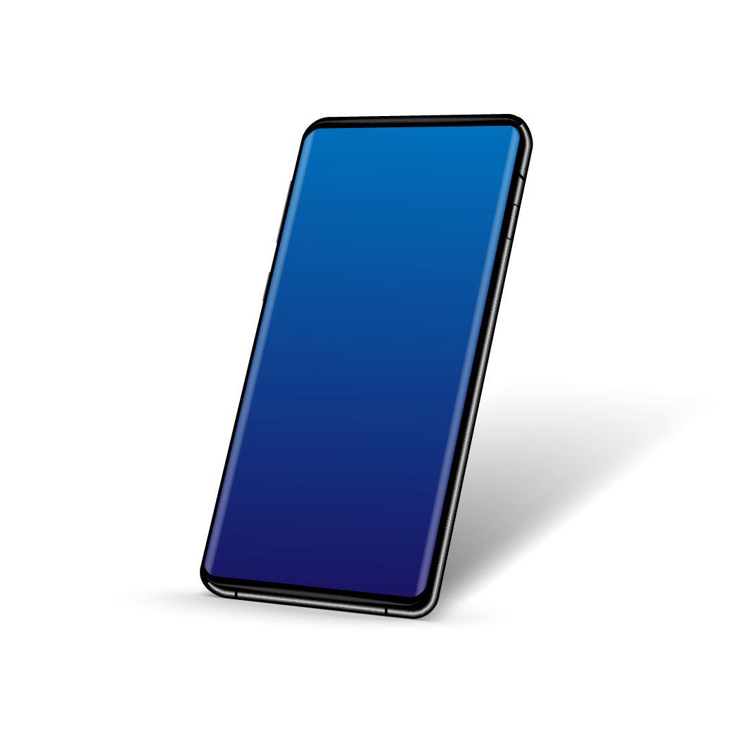
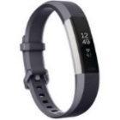
Non-invasive Health Monitoring: Smart App
Couples existing external fitness tracker data (heart rate, ECG, steps, behavioral, geospatial) to phone
“Achievement” app provides daily symptoms questionnaire – couples results with fitness data to predict illness
Notes:
Partnering with Gates and Seattle Flu Study on clinical studies during Flu season collecting health signature data coupled to pathogen identification to identify signs of impending disease
Can greatly enhance public health monitoring for infectious disease
Clinical Study Active now-5250 Patient Cohort monitored daily via Fitbit &
Influenza-like illness (ILI) symptom reports
Once symptomatic, immediate swab at home for rapid Flu testing plus molecular test for 8 viruses that can cause ILI

Slide 40
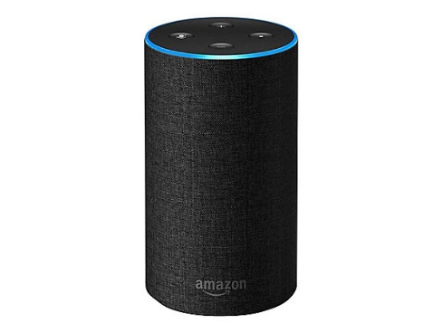
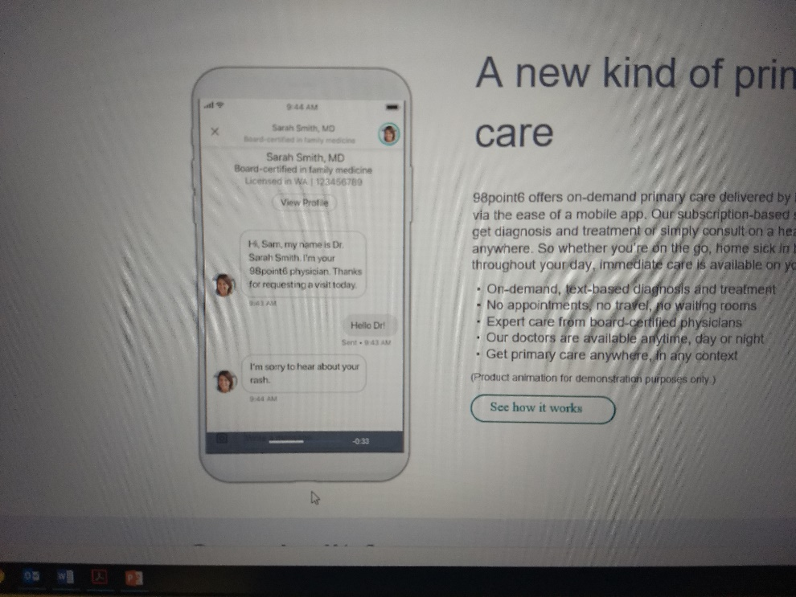

In-Home Monitoring
Telehealth
Software transforms commodity smart devices into active sonar system
Contactless respiratory monitoring
Telemedicine app connects user to board-licensed physician
Real-time epidemic information
Over 500k daily users
Notes:
Sound: Can a home speaker device monitoring breathing predict impending disease?
Software can be readily also applied to Opioid overdose warning (addiction & pain management); aid search & rescue; enhance treatment of chronic ailments
Software transforms commodity smart devices into active sonar system, capable of contactless respiratory monitoring to identify early ARI illness onset.
98.5: Can we use primary care contact cases to enhance the timeliness and efficacy of disease monitoring strategies?
A new approach to primary care, using technology to bring affordable, on-demand access to everyone
Telemedicine provider using smartphone interface to connect patients nationwide to board-certified primary care providers
Potential to provide real time epidemic information and outbreak monitoring of new biological threats to health authorities
Over 500K daily users in all 50 states

Slide 41


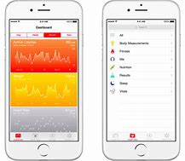
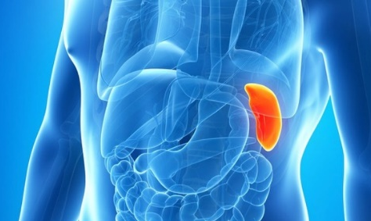
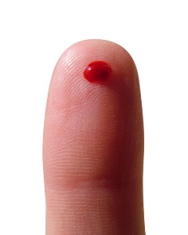
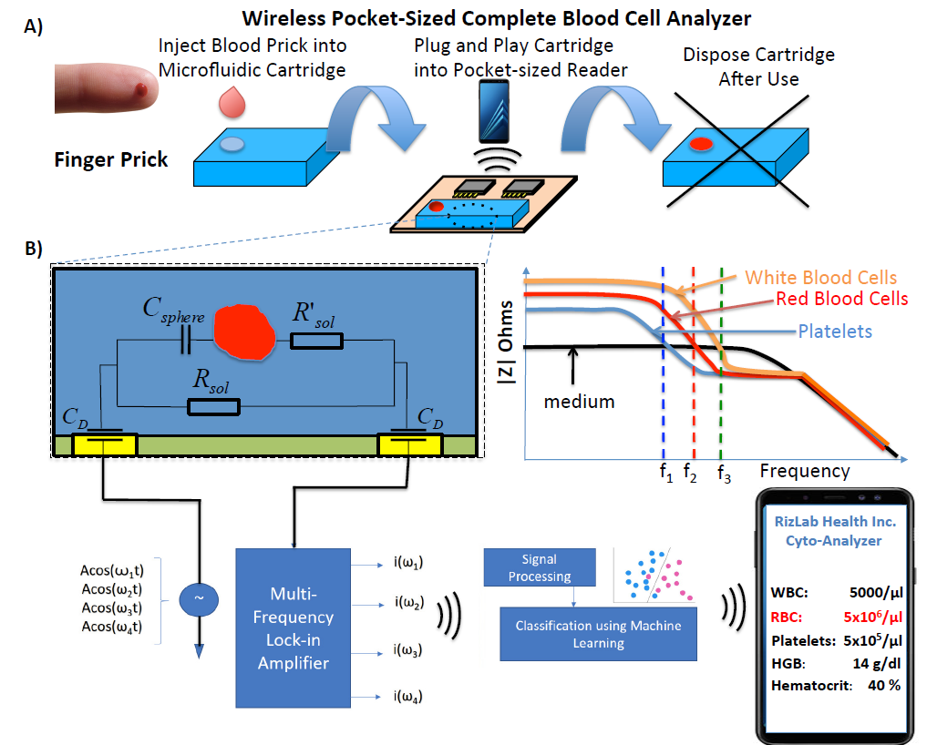

Point-of-Care Analysis
LYMPH
BM1 BM2 BM3
SPLEEN
BM1 BM2 BM3
Pocket-sized blood analyzer determines blood count, immune activation via cell morphology changes
Rapid test to distinguish viral from bacterial infection
Lab-on-a-Dust system (LDS)
CRP, TNF-alpha, IL-1RA
No prep; sample-to-answer: 15 min
Development of stress model involving biomarker signatures
Ultrasound detects changes in biomarker expression / immune cell responses
Notes:
Rizlab Health:
Data-Driven Home Monitoring System for Classifying Viral/Bacterial Infections
Pocket-sized blood analyzer provides CBC at the ER/Physicians’ Office/In The Home Utilizes impedance cytometry to count white blood cells and determine immune activation via morphological changes to those cells
Enables patients to perform a rapid virus/bacteria test to send to their clinician to enhance antibiotic stewardship
Enables first responders to get rapid CBC to enhance potential for life-saving treatments not now available before arrival at hospital
Stanford:
A fully integrated, RF powered, multiplexed, 1mm² MDx system on a disposable CMOS chip immersed in clinical sample and wirelessly transmits results to phone
no sample prep, instrumentation reagents required
Sample to answer: 15 min
Can be used for home-based diagnosis of disease, clinical trial monitoring, rapid triage by emergency responders
Prototype will detect CRP, TNF-a and IL-1RA at [pM] from a finger prick

Slide 42
DRIVe Solving Sepsis Program
Kimberly Sciarretta, PhD

Slide 43


US Sepsis Stats
INCIDENCE*^{2,3}
MORBIDITY*¹
MORTALITY*¹
ECONOMIC BURDEN*⁴
86.8%
1.7
responsible for
Million
Of sepsis cases were present on admission
~270,000
$60+
each year in U.S.
Americans die each year
Billion
>40%
>80,000
Of Severe sepsis transported by EMS
are discharged to hospice
Annually
*¹CDC.Gov
²September 13, 2017. doi:10.1001/jama.2017.13836
³December 15, 2012 doi: [10.1164/rccm.201204-0713OC]
⁴Critical Care Medicine 2020; 48(3): 276-318
Notes:
Stats have likely increased due to COVID-19

Slide 44




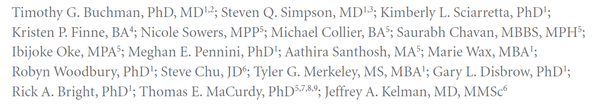
Sepsis Among Medicare Beneficiaries: Manuscript Trilogy
The Trajectories of Sepsis 2012-2018
The Methods, Models and Forecasts of Sepsis 2012-2018
The Burdens of Sepsis 2012-2018
Critical Care Medicine 2020; 48:276-318

Slide 45
All Roads Can Lead to Sepsis
Hemorrhagic fevers
Anthrax
SARS – CoV2
Influenza
Sepsis is a secondary confounder that arises from primary infection or secondary infection from a primary insult (burn, etc.) and threatens our ability to protect our Nation
Plague

Slide 46











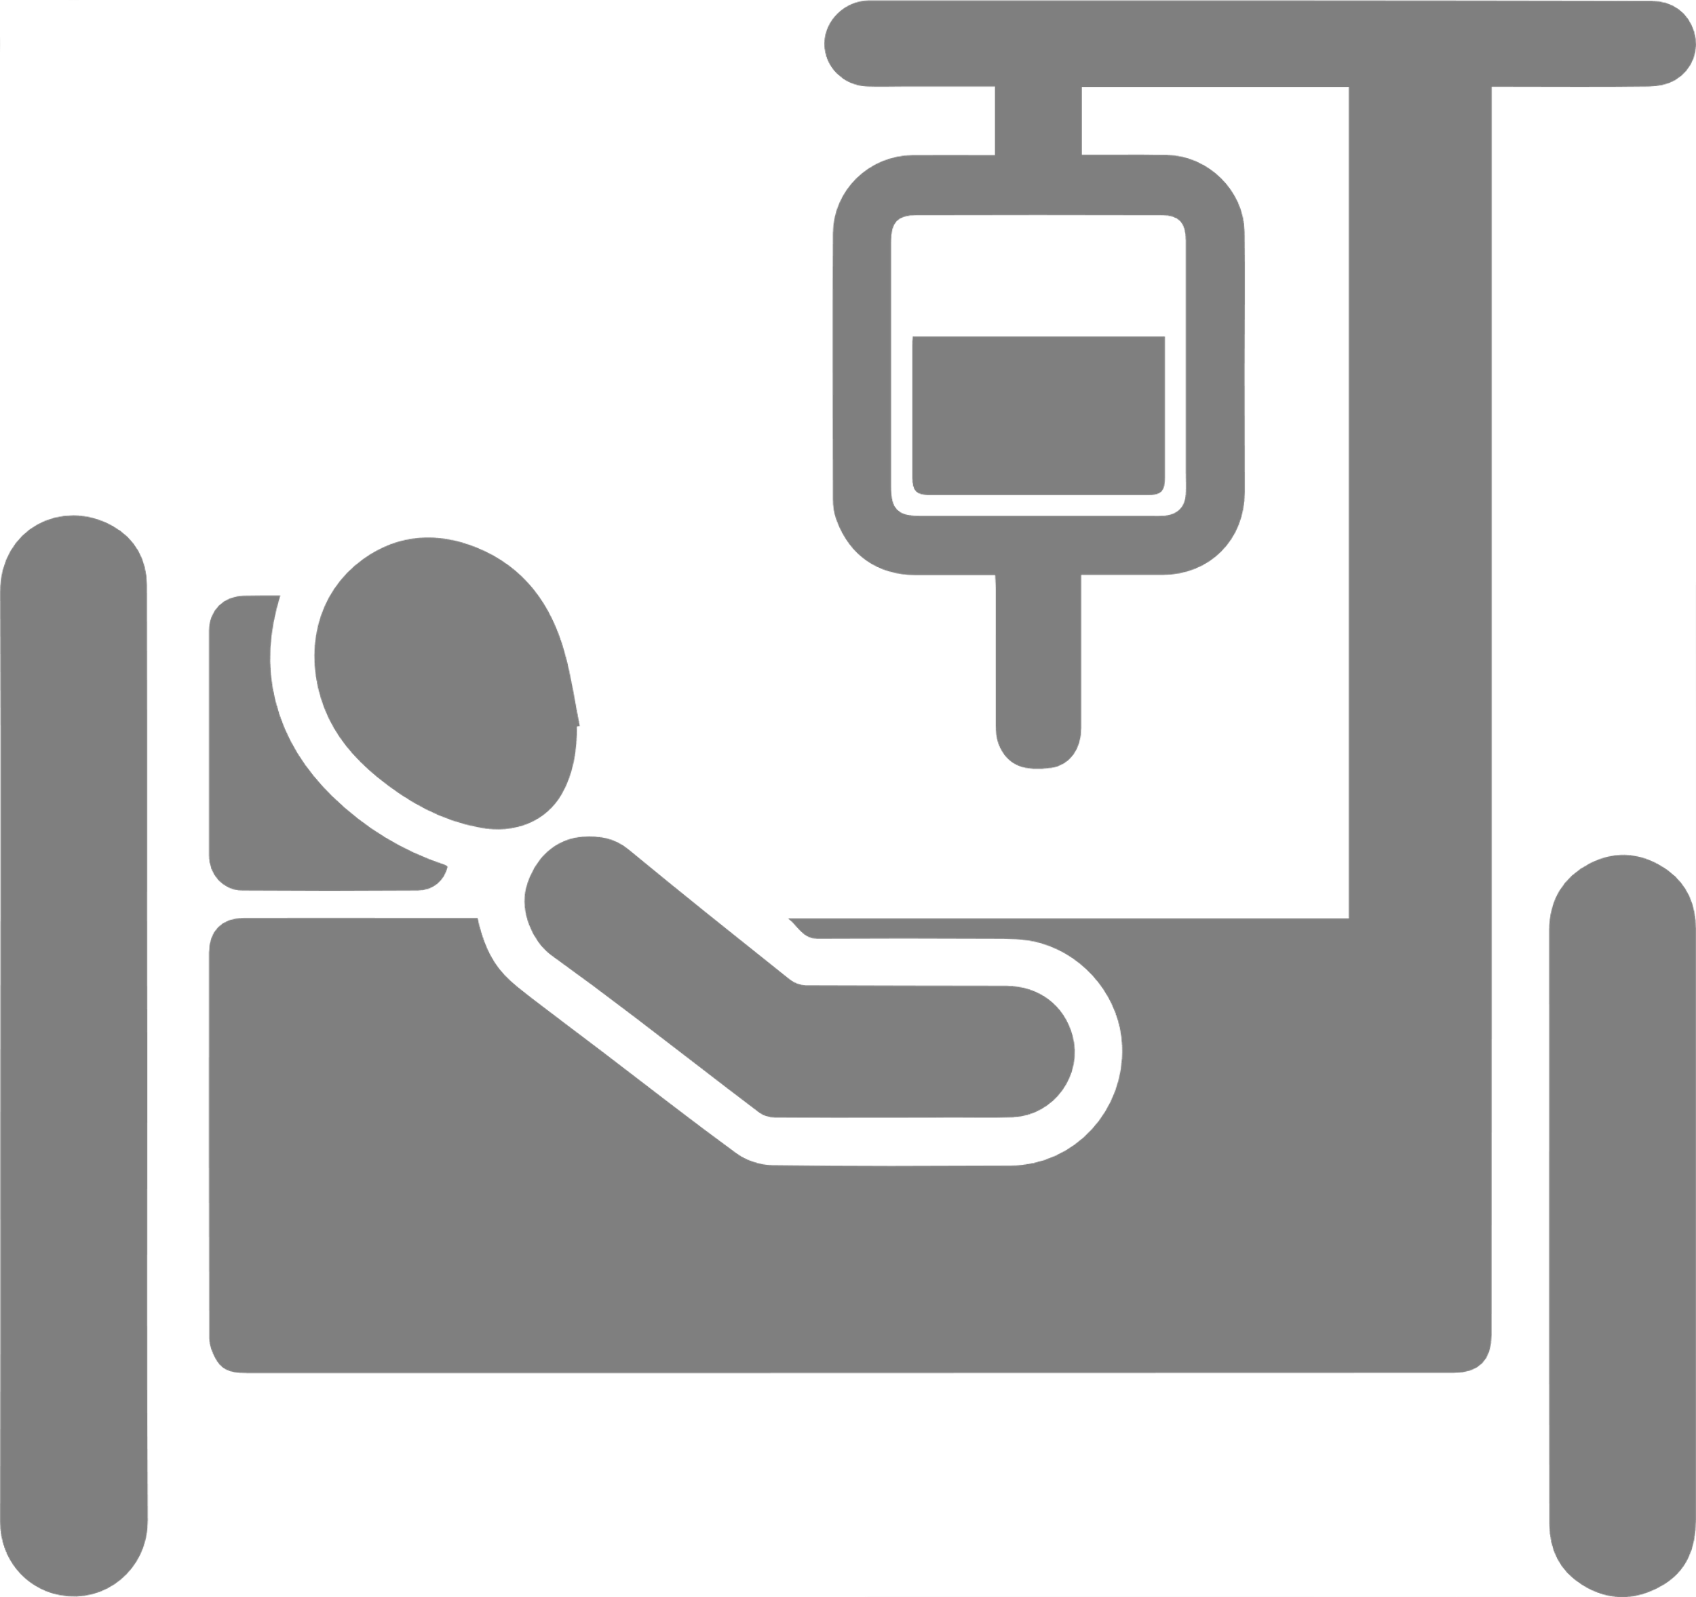










Solving Sepsis Strategy
DRIVe Solving Sepsis aims to reduce the incidence, morbidity, mortality and cost of sepsis by investing in key strategic areas
AWARENESS
PREDICTION
DIAGNOSIS
PROGNOSIS
TREATMENT
RECOVERY

Slide 47
Sepsis Patient Continuum Each Red Node is an Opportunity to Intervene
SURVIVALResilience
HOSPITAL ACQUIRED
(<20%)
RELEASE
Post-sepsis
Syndrome
PREVENTION
ORGAN DYSFUNCTION
SHOCK
ONSET
INFECTION
RE-ADMISSION
T=0
Sepsis Phenotype
Detectable
Physical Signs
COMMUNITY ACQUIRED
(>80%)
MORTALITY
Solving Sepsis is catalyzing approaches for interventions along the entire continuum
Notes:
All populations are important – adults, pediatrics, neonates
1.7 million Americans Develop sepsis and 270,000 adults
I wanted to present to you a perspective on how we are currently thinking of Sepsis and potential intervention points.
Each red node a point along the patient continuum, represents a point of intervention
Blue bar represents when a patient may present with Sepsis
Framework for meeting
T=0, unknown today
Note, no temporal capture
You will see this same slide repeated in the presentations today as we think this is a good map as to how
If you have any comments on this vision pelase capture on post-it and place on patient continuum – working model

Slide 48
Sepsis and Severe COVID-19 Disease
Sepsis
Infection
Organ dysfunction
Dysregulated host response
Severe COVID-19 Disease
SARS-CoV2
Dysfunctional organs
Pulmonary
Cardiovascular
Renal –
Neurological
Thrombostasis
Hepatic-
Dysregulated host response – ”cytokine release syndrome”
https://www.phe.gov/ASPRBlog/pages/BlogArticlePage.aspx?PostID=378
https://www.phe.gov/ASPRBlog/pages/BlogArticlePage.aspx?PostID=379

Slide 49
A perspective: COVID-19 Continuum of Care
SURVIVAL Resilience
Community Mild Illness (~80%)
Severe Infection (~20%)
HOSPITAL DISCHARGE
ASYMPTOMATIC
SYMPTOM
ONSET
MILD ILLNESS
VIRAL PNEUMONIA
SEPTIC SHOCK
PREVENTION
INFECTION
SEPSIS
ARDS
LONG TERM SEQUELAE
Threat Agnostic Approach
MORTALITY
AWARENESS
PREDICTION
DIAGNOSIS
PROGNOSIS
TREATMENT
RECOVERY
Educate/Public Awareness
Training webinars
Diagnostic Tools for Disease Severity
EHR digital tools
host-based blood IV Diagnostics
Host-based therapeutics
Post-ICU discharge/Long-Terms Sequelae
Diagnose deterioration

Slide 50
Sepsis Tools can be a Roadmap for Resiliency
Sepsis is often endpoint of any severe infectious disease
Pathogen agnostic, as it is the host response
Awareness will build confidence
Public education
Knowledge of best practices in face of an unknown
Host based diagnostic for identification of infection severity
Host targeted therapeutics/ clinical management for restoring host homeostasis
Post-sepsis/disease monitoring/interventions to prevent health deterioration/additional mortality
Empower Health Care Provider
Triage severely ill to determine need for Hospital care/ICU
Allocate hospital resources
Identify health deterioration or decompensation in patients that need care to allocate/shift resources (personnel, equipment, etc)
https://www.phe.gov/ASPRBlog/pages/BlogArticlePage.aspx?PostID=383

Slide 51
Solving Sepsis Program – Next Steps
EZ BAA Area of Interest
Focus Areas
Technologies that address neonatal and pediatric populations (diagnostics, devices)
Post-sepsis monitoring that detects deterioration to empower patient/provider
Patient stratification/endotyping for improved health outcomes
(Prediction/Diagnosis): sepsis in pre-hospital settings
Infection severity diagnostic stewardship
Creation of strategies to improve clinical utility post-market
Support regulatory path of products
Engagement of FDA and BARDA-funded sponsors
Data analytics
Including burden of sepsis
Expand sepsis messaging as a roadmap
Notes:
Talking points to add:
Translational Science
FDA pathway
Commercialization

Slide 52
New Program Area: Beyond the Needle
Donna S. Boston
Director, BtN Program

Slide 53
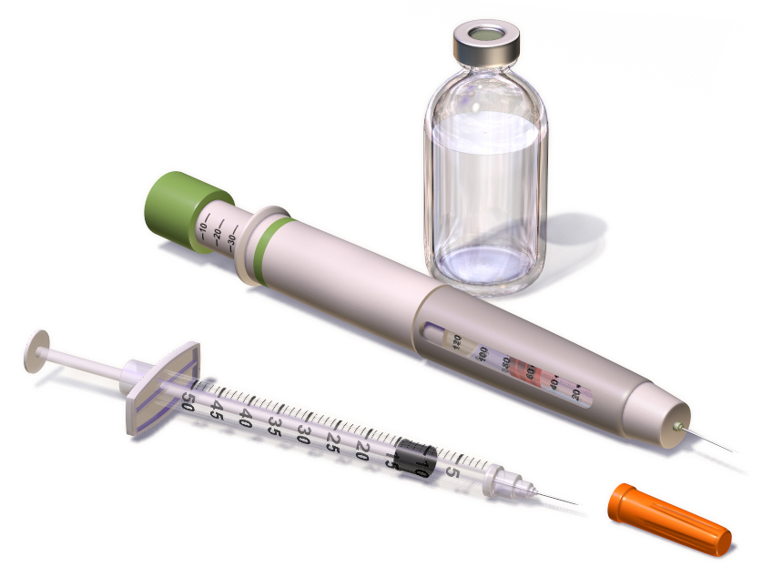


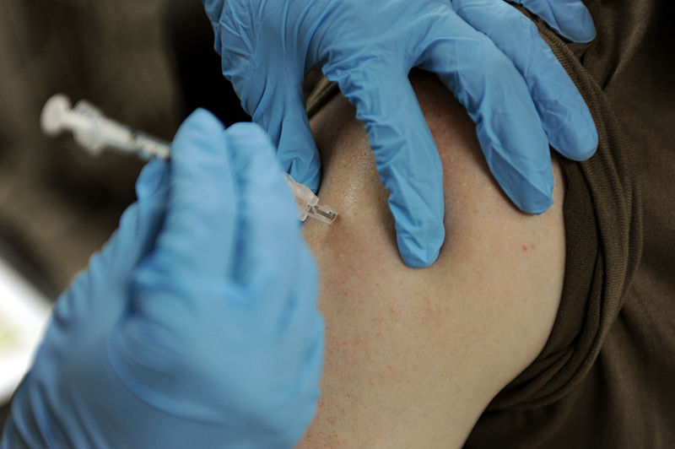
Beyond the Needle: Breaking with Tradition
Vaccination saves lives. But there are inherent risks with the standard intramuscular injection method of vaccine administration, especially in a pandemic.
Strain on supply chain – needles, syringes, vials –100s of millions needed
Logistics burden of distributing supplies, cold-chain requirement
Compliance -- fear of needles; difficulty getting to clinical setting; may need boosters
Resource constraints, requires qualified healthcare providers to administer

Slide 54

Beyond the Needle: Program Goals
To break the needle-and-syringe paradigm, BARDA and DRIVe are innovating ways to move Beyond the Needle
Transforming Vaccination
Reducing the Resource Burden
Wider Availability
Example Technologies:
Expand beyond the vaccine-by-injection paradigm
Enhanced compliance due to ease of administration, no needle sticks
Could offer single-dose administration (no boosters), dose-sparing
Potential to reduce reliance on needle/syringe supply chain
Aiming for self-administration, reducing the burden on qualified trained healthcare professionals who are in short supply
Wider distribution to more types of settings, potentially even at-home use
Easier and more efficient to manufacture, store and deploy when and where needed
Shelf-stable, eases cold-chain storage and distribution requirements
Oral formulations, trans-dermal implants or wearable skin patches, inhalation routes (aerosol)

Slide 55

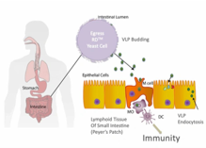
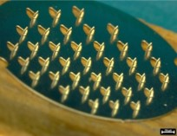
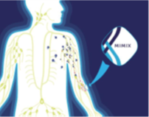
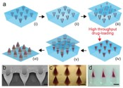
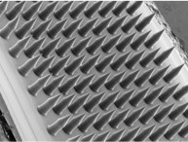

Beyond the Needle: Projects
EGRESS rapid deployment oral vaccine for COVID-19
Shelter in Place COVID-19 vaccine VaxiPatch™ (skin patch) Vaccination Kit
MIMIXTM COVID-19 Single-Dose, Shelf-Stable, Self-Applied SARS-CoV-2 Vaccine (skin patch)
Shelf-stable, dissolvable microneedle skin patch with timed-release of vaccine
ImplaVax® solid-dose pandemic influenza vaccine implant
3D-printer fabrication process for automated, distributed manuf’g of vaccine patches
Notes:
We aim to make needles needless!

Slide 56
Chemical Repurposing: DRIVe ReDIRECT - AOI #5 “Treat the Injury, Not the Agent”
Holy Grail:
An easily accessible and effective MCMs that is available in community hospitals, pharmacies, and within the community
Chemical Repurposing Pipeline
Chem Branch
FDA Approval
DRIVe
Proof of Concept Studies
Advanced Clinical Development
Primary & Secondary Indications
Focus Areas: Pulmonary agents, vesicants, opioids, blood/metabolic agents, organophosphates or nerve agents, and computational approaches to drug discovery for chemical repurposing

Slide 57



BARDA Next Generation Mask Redesign Prize Challenge Competition
A prize challenge to improve the “comfort, utility, and protective factor” of masks for the general public.
Two Phases:
Phase 1: Concept Design Submissions Open: Oct 27 Submissions Close: Dec 31
Phase 2: Prototyping & Testing Submissions Open: March 1, 2021 Submissions Close: August 31, 2021
For more information, go to www.insertwebsitehere.gov

Slide 58


BARDA Division of Contracts Management & Acquisition (“DCMA”), Division of Research Innovation & Ventures (“DRIVe”) Acquisitions Team

Slide 59



DRIVe Acquisitions Team: EZ-BAA 2.0 & COVID-19 Response
EZ-BAA
FEB 2020
500+
32
9
Opened for Business
Submissions Received
Contracts Executed
Fewest Number of Days from Abstract to Award
Notes:
Don’t say “hopefully” this will make it easier. It WILL make it easier.

Slide 60

DRIVe Acquisitions Team: Aligning Interests
Every DRIVe contract has included a cost-share element
2020 DRIVe PROJECTS (TBD DATE)

Slide 61



DRIVe Acquisitions Team: BARDA Ventures
‘21st Century Cures Act’ BARDA authorized BARDA to utilize “strategic venture capital practices and methods […]”
(see (P.L. 114-255)
Extensive Market Research
and
Requirement Development
Solicitation Released [INSERT DATE]

Slide 62





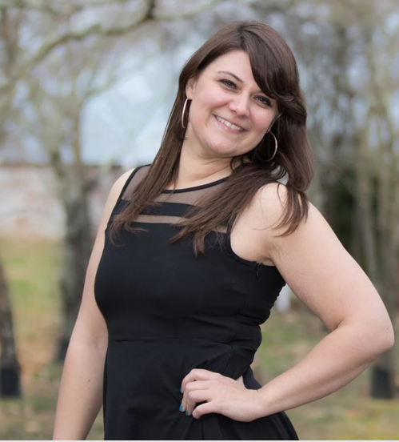

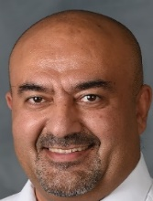


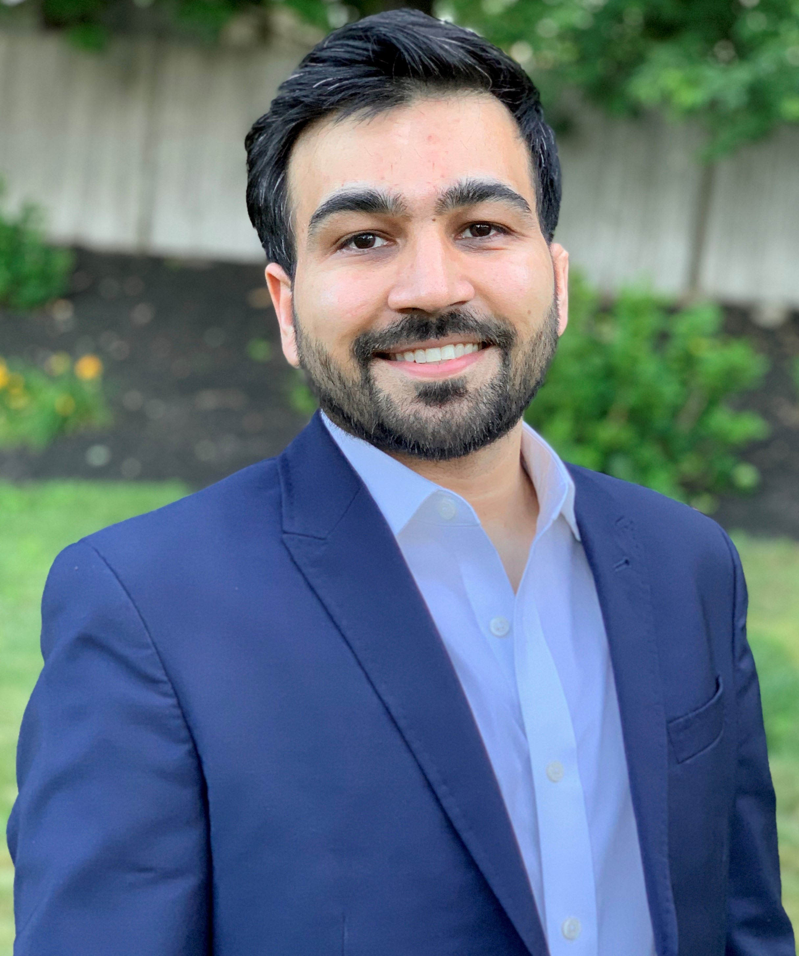


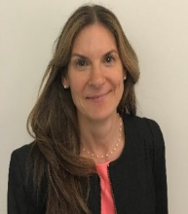
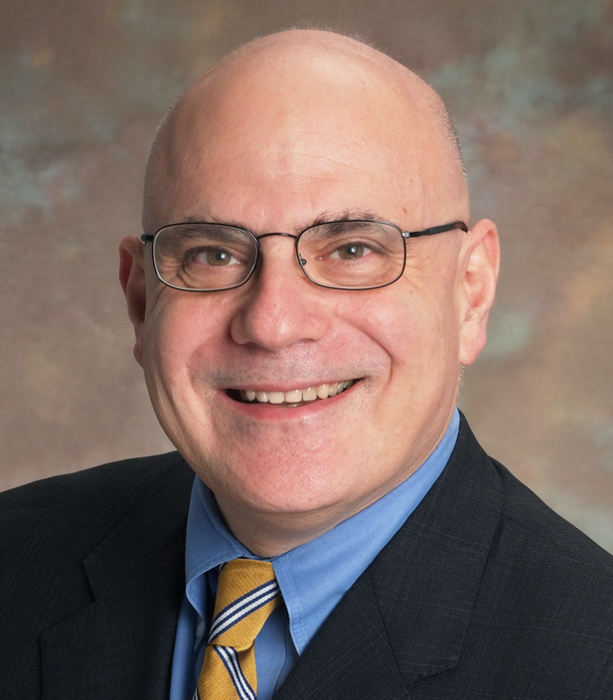
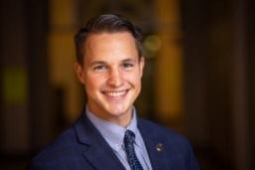



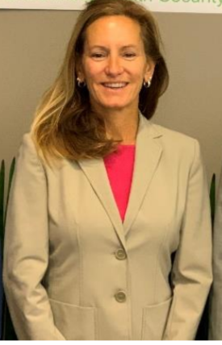








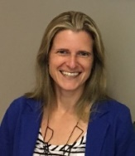



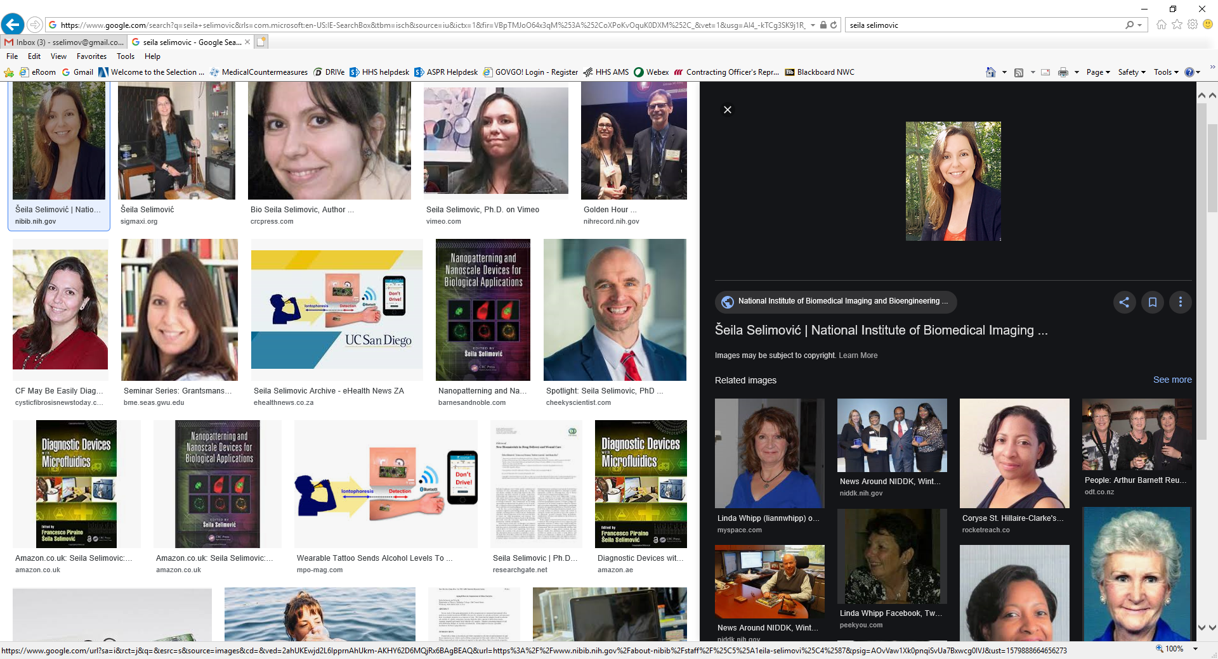

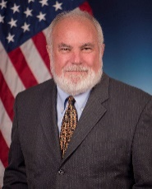
2020 Annual Retreat Team Photo
Meet Team
Dr. Pen

Slide 63



Questions?
DRIVe.hhs.gov
Sandeep Patel, PhD
DRIVe Director
Sandeep.Patel@hhs.gov
@innovationwonk

